Slide 1
Addressing the school dropout rate
Presented by: PURPLE CODE

Slide 2
Background
Increased number of university graduates -> increased GDP output (Moore, 2006)
More dropouts -> less enrollments -> less graduates
Why students dropout (Rumberger, 2001)
individual vs institutional characteristics
4 types of institutional characteristics
2nd type is RESOURCES
E.g. TEACHER/RATIO
Notes:
An increase in University graduates leads to an increase in GDP output
However having dropouts means that there’s less students who can enroll at universities which means that there’s less graduates
The reasons why students dropout are categorised into 2 types of factors: individual and institutional characteristics. Within institutional characteristics there are for types of characteristics, the second of which are the resources of the institution. Here studies show that pupil/teacher ratio had a positive and significant effect on dropout rates.

Slide 3
Problem definition
There is gap in the percentage of learners who enrol at basic education to those who successfully graduate on to institutions of higher learning (NSC Examination Reports 2021) and this can be traced to the situation at Universities, where the less people are enrolling for education certificates so a good place to start would be to increase the amount of educators available for learning.
Notes:
The problem of

Slide 4
Project objectives
Looking at the bigger picture to be achieved is :
-Provide better and equal access to education
*implement a learning recovery program
-bridge the gap in education system
*ensure that most of the enrolled learners are able to successfully complete their academic journey .
Notes:
In the project objectives ,we are looking at the goals that we would like to achieve by the end of our research project .
1st Goal: which is to provide a better and equal a
ccess to education where we will implementing a learning recovery program that will ensure that learners who have fallen behind to quickly revise their support and catch up to the expected learning target .
2nd goal : which is to bridge the gap in the educational system where we want to ensure that more enrolled learners are able to successfully complete their academic journey.

Slide 5
Study area
Casual learning which examines correlations to find patterns within large datasets.
evaluate the status of education in South Africa,.
education under covid 19
Effectiveness of the current online learning
why an intervention is needed to provide better quality education.

Slide 6
Methodology
Business understanding
Analytic Approach
Data Requirements
Data Collection
Data Understanding
Data Preparation
Model Training
Model Evaluation
Deployment
Notes:
This is the methodology we’ve adapted and it aspects of it will be discussed in detail as we go along the presentation

Slide 7
Data Resources and Analysis
The datasets used to conduct this project was put together by the Centre for Higher Education .
The data sets includes :
1.Enrolments by Major Field of Study
2.Enrolments by Qualification Type
3.Graduates Percentage
Source: South Africa Higher Education Performance Indicators (2000 - 2012)
Futhermore, a survey paper was also included.
COVID-19 and its impact on education, social life and mental health of students: A survey. Children and youth services review
https://www.kaggle.com/muhammadgusanwaakbar/learning-situation-on-new-delhi-in-covid-19-era

Slide 8
Set 1 : Datasets description
These three datasets contain data from 23 South African Institutions and values are recorded from 2000-2012
Enrolments by Major field of study
- 92 values of classes Science, Business, Humanities and Education
Enrolments by Qualification type
- 69 values of classes Undergraduate, Postgraduate up to Masters and Doctorates
Graduates percentage
- 23 values of percentages of graduates

Slide 9
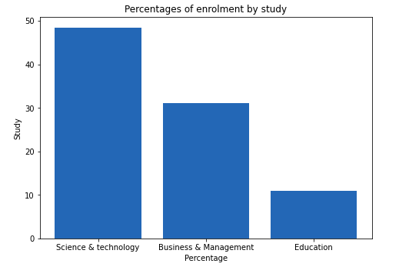
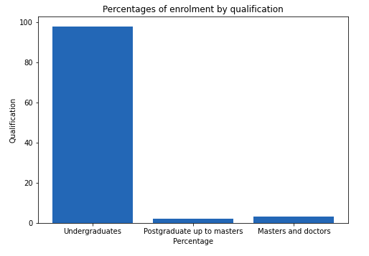
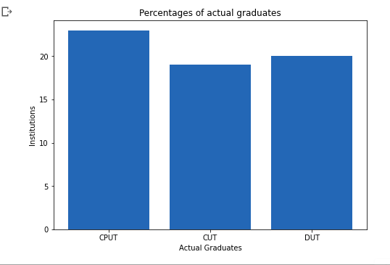

Slide 10
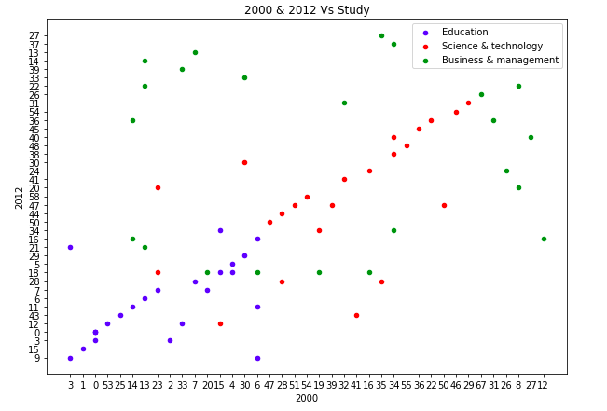
Data Resources and Analysis

Slide 11
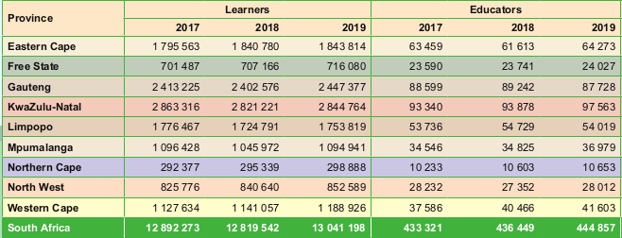
School realities

Slide 12
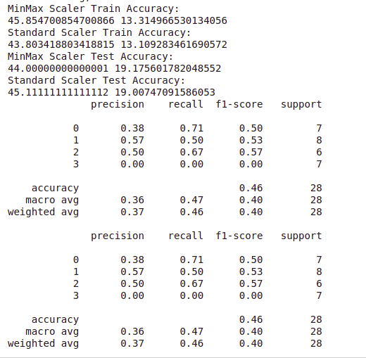

Slide 13
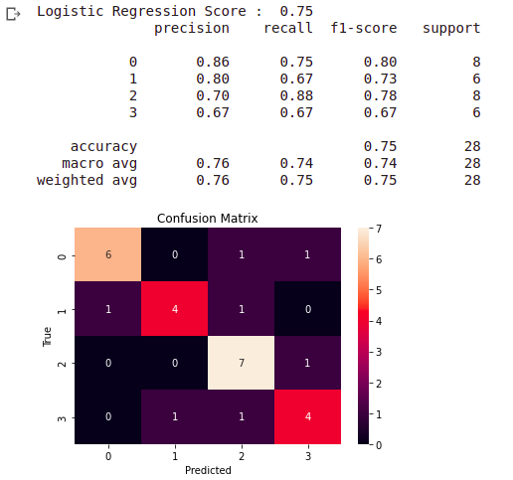

Slide 14
Set 2 : Dataset description
This dataset is cross sectional survey conducted with a sample of 1182 students of different age groups from different educational institutions in Delhi

Slide 15
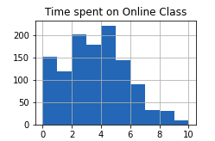
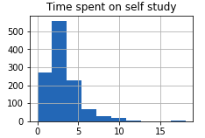
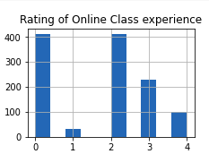
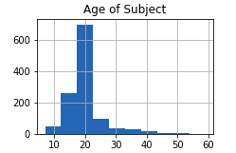

Slide 16
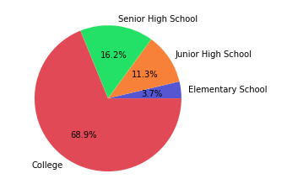

Slide 17
Proposed solution
create a web application that will allow us to weaken one of the strong factors identified
our web application will be able to:
register educators around the country who are able to assist learners with subjects they have difficulties in.
register schools who are have a lack of educators.
register learners who are individually struggling.
the learners and educators to communicate painlessly and any time.

Slide 18
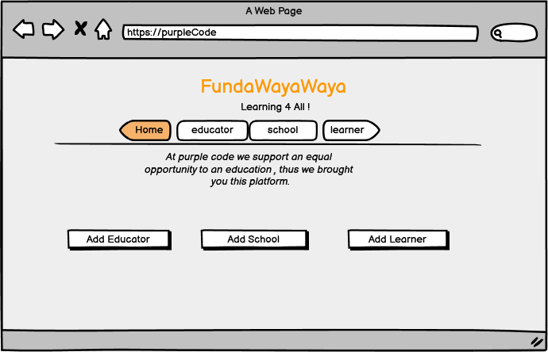
Proposed solution

Slide 19
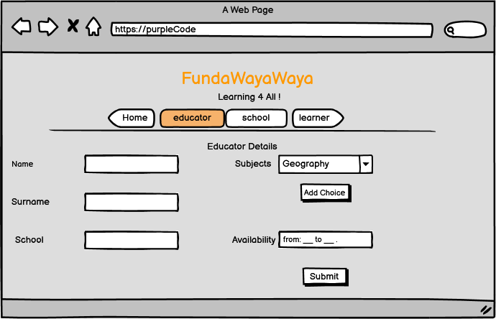
Proposed solution

Slide 20
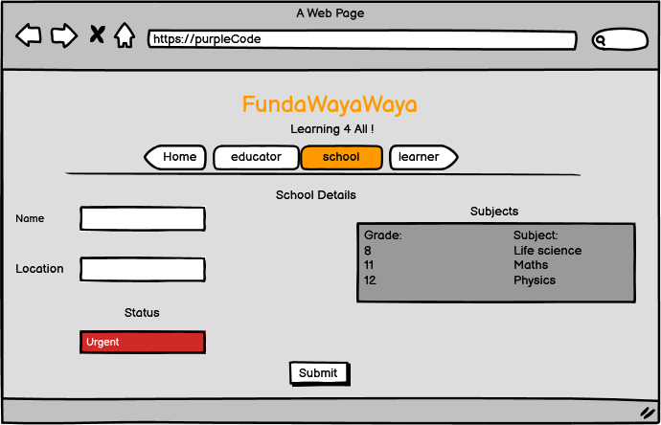
Proposed solution

Slide 21
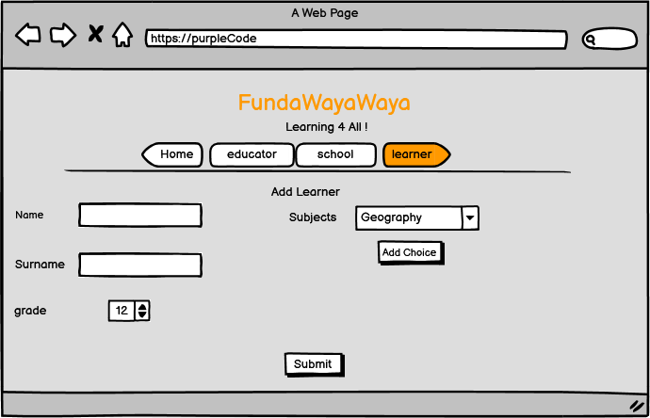
Proposed solution

Slide 22
Conclusion and Future Recommendation
The solution is intended to bridge the dropout gap at basic education using available human resources.
Future recommendation: encouraging more trainers for online technical skills at basic education
Notes:
The solution is intended to help learners successfully complete their basic education by equipping university students to become educators in their respective fields - in a way recycling the knowledge that allowed them to be where they. The aim is also to foster mentorship and volunteering culture

Slide 23
References
Chaturvedi, K., Vishwakarma, D.K. and Singh, N., 2021. COVID-19 and its impact on education, social life and mental health of students: A survey. Children and youth services review, 121, p.105866.
Moore, W., 2006. 'A Graduate in Every Household': The Potential Impact of a Rise in the Number of University Graduates on Output in Barbados. Journal of Eastern Caribbean Studies, 31(3).
Rumberger, R.W., 2001. Why students drop out of school and what can be done.
Rumberger, R.W. and Lim, S.A., 2008. Why students drop out of school: A review of 25 years of research.

